Slide 1
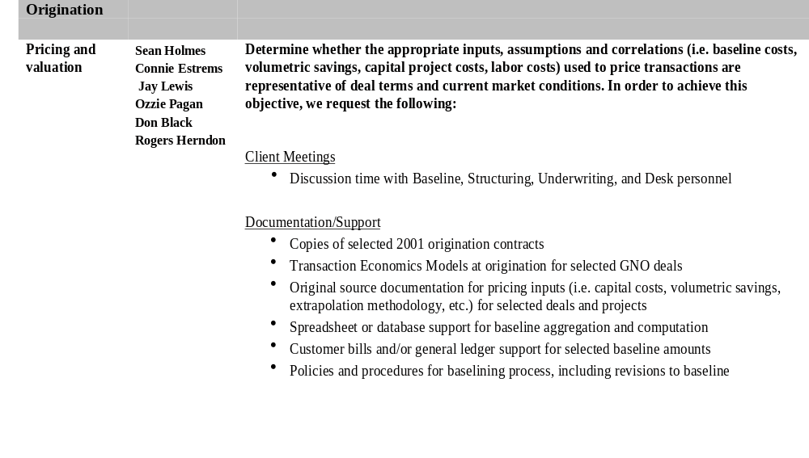
2001 Audit Areas of Emphasis
Functional EES
Area Business Owner Objectives
47FL Share/EES/Business Audit Planning/2001 Audit Plan_Request List

Slide 2
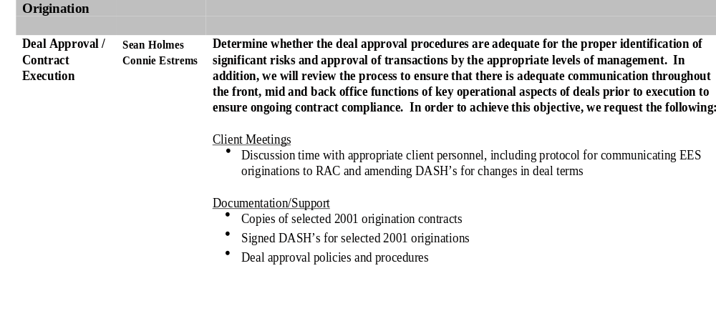
2001 Audit Areas of Emphasis
Functional EES
Area Business Owner Objectives

Slide 3
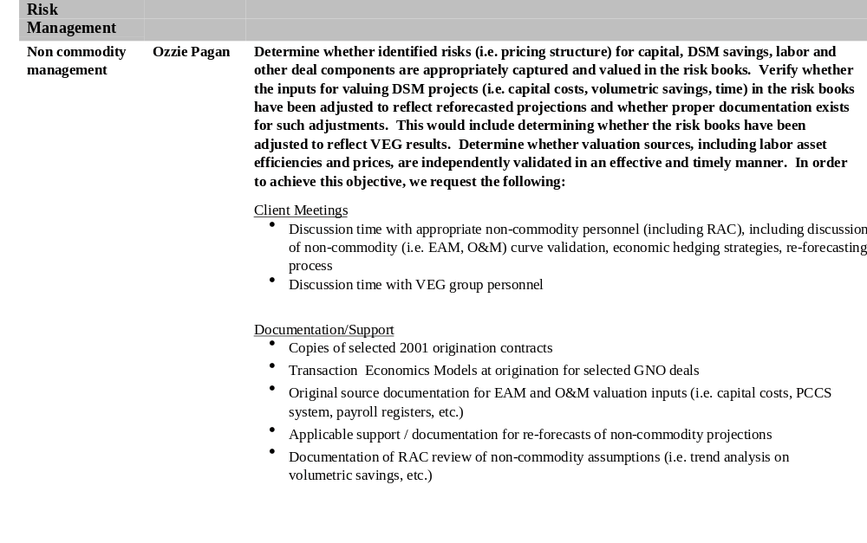
2001 Audit Areas of Emphasis
Functional EES
Area Business Owner Objectives

Slide 4
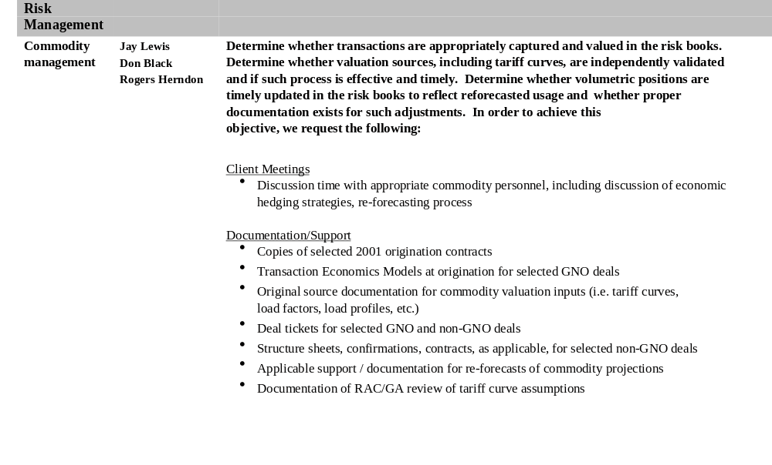
2001 Audit Areas of Emphasis
Functional EES
Area Business Owner Objectives

Slide 5
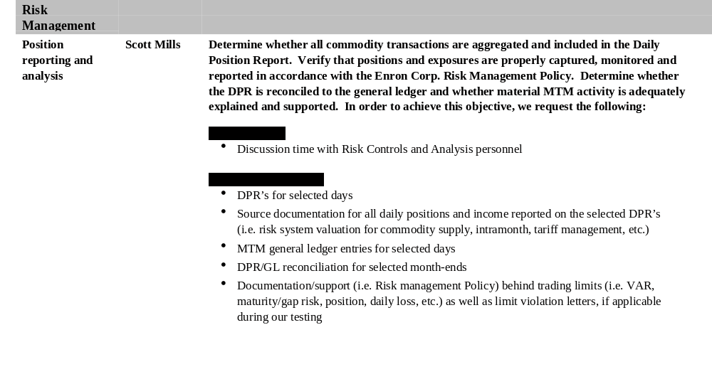
2001 Audit Areas of Emphasis
Functional EES
Area Business Owner Objectives

Slide 6
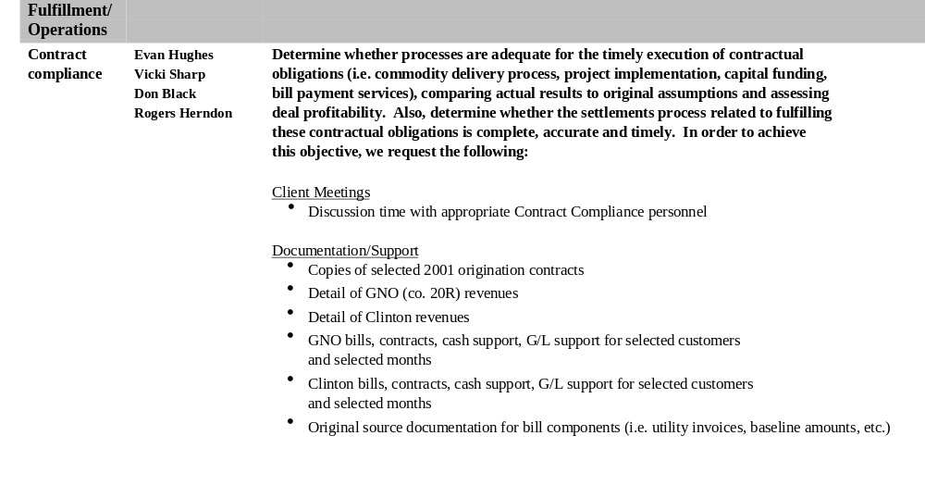
2001 Audit Areas of Emphasis
Functional EES
Area Business Owner Objectives

Slide 7
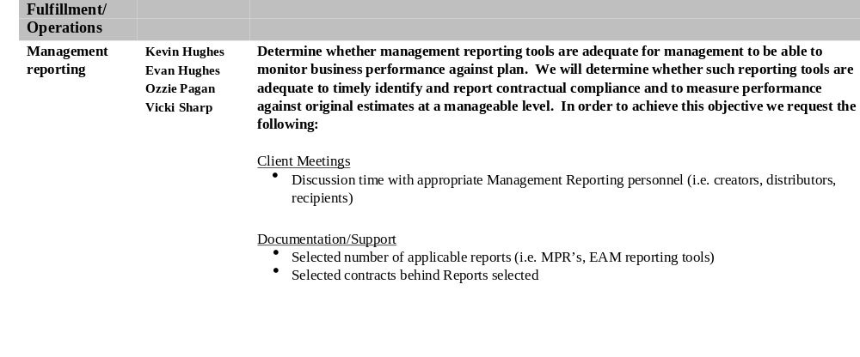
2001 Audit Areas of Emphasis
Functional EES
Area Business Owner Objectives

Slide 8
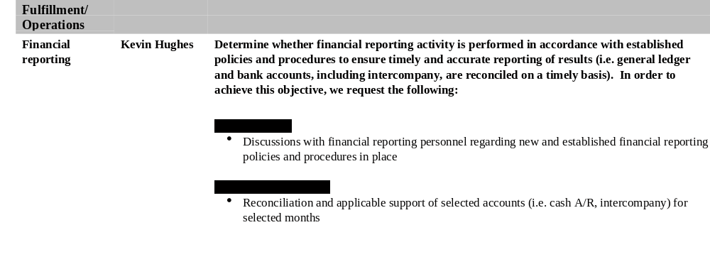
2001 Audit Areas of Emphasis
Functional EES
Area Business Owner Objectives

Slide 9
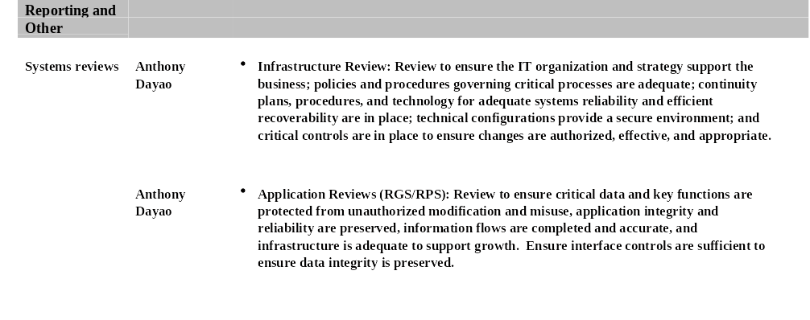
2001 Audit Areas of Emphasis
Functional EES
Area Business Owner Objectives

Slide 10
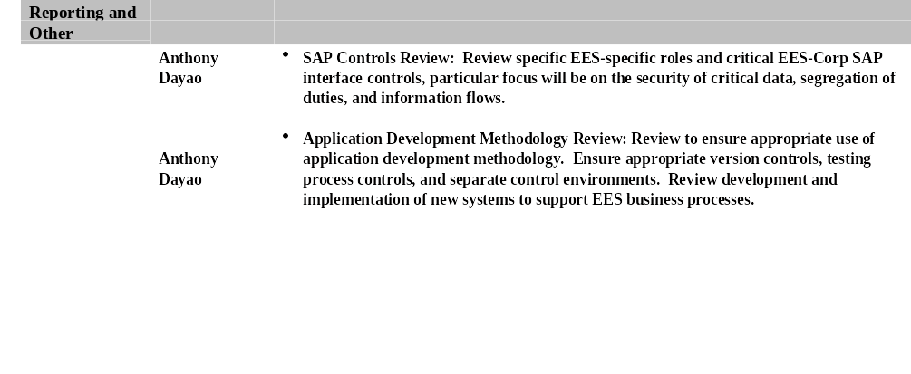
2001 Audit Areas of Emphasis
Functional EES
Area Business Owner Objectives

Slide 11
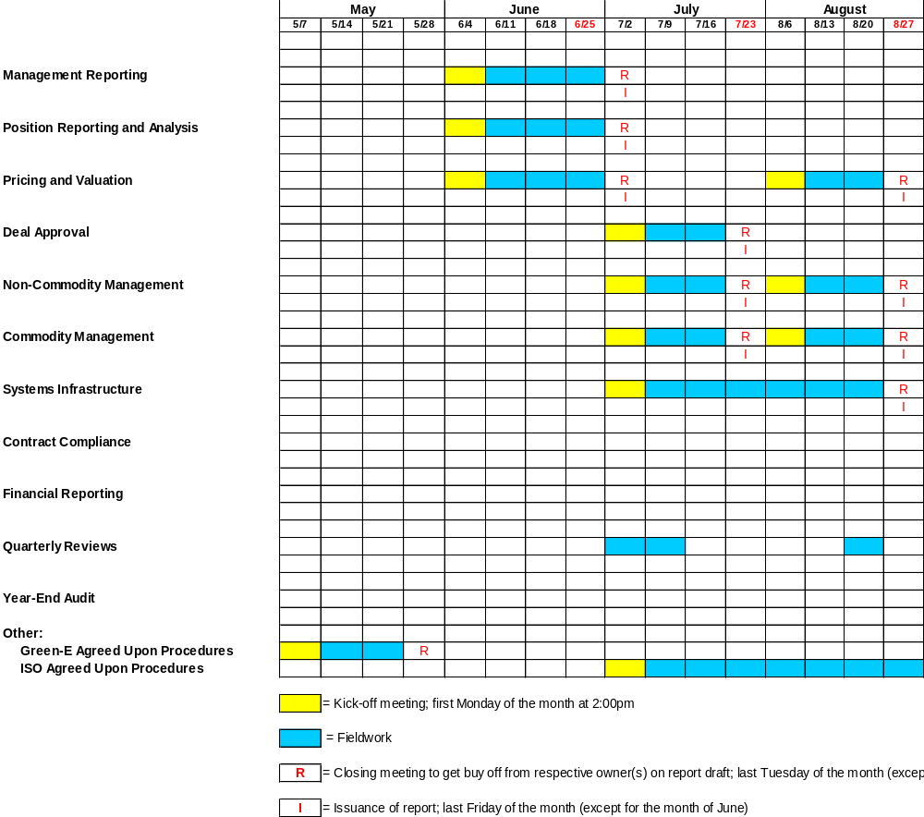
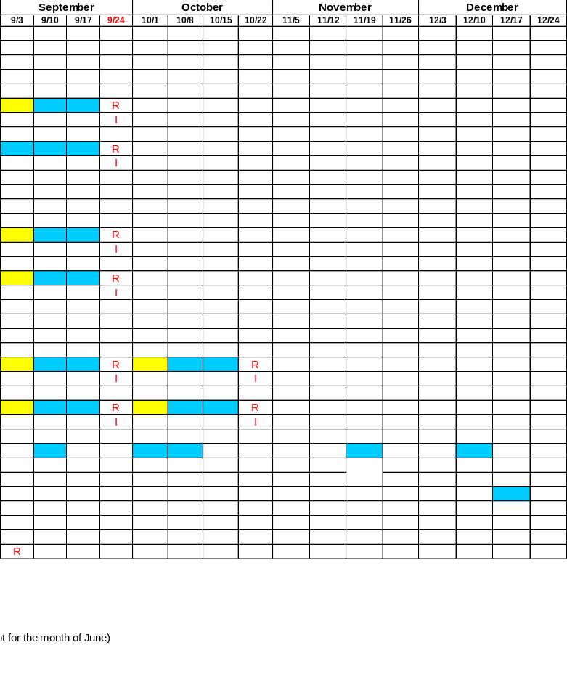
2001 EES Business Audit and Year-End Audit
Fieldwork and Reporting Periods

